Slide 1

Trips Dashboard – Data Analysis & Technical Recommendations
Abdul Wasi Stanikzai
Date: 06/04/2025

Slide 2

Introduction
Overview of the project’s purpose and scope
Objective: Enhance operational efficiency and decision-making using Power BI analysis of trip data

Slide 3
Data Overview
Tables used: Trips, Trip_Details, Duration, Payment, Assembly
Total Rows Analyzed: 983 trips
Joined using keys like tripid, loc_from, faremethod, duration

Slide 4
Methodology
Data cleaning: removed nulls, handled invalid fare/distance
Created calculated columns: trip status, duration bins
Developed DAX measures: Total Revenue, % Completed Trips, etc.
Tools used: Power BI, DAX, Power Query

Slide 5
KPIs & Key Metrics
Total Trips: 983
Total Revenue: 751K
Avg Distance: 14.39 km
Avg Trip Duration: 12.34 mins
Visual: KPI cards

Slide 6
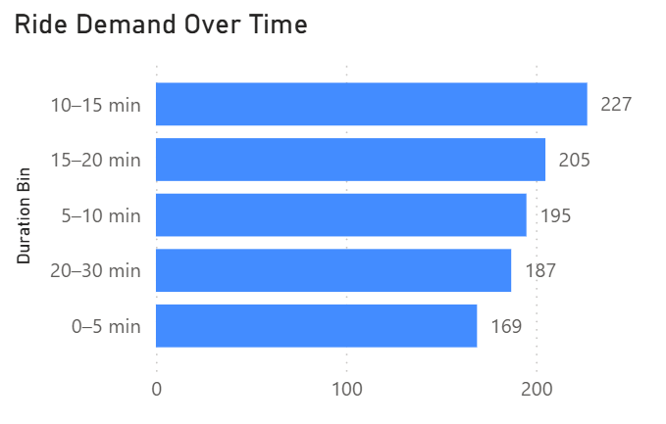
Ride Demand Over Time
Bar chart of trip counts by duration group
Insight: 10–15 min trips are most common and efficient

Slide 7
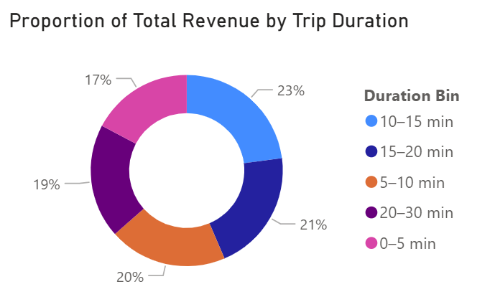
Revenue by Time Duration
Donut chart of revenue share by trip duration
10–15 min trips contribute ~23% of revenue
Strategic focus on mid-duration trip offers

Slide 8
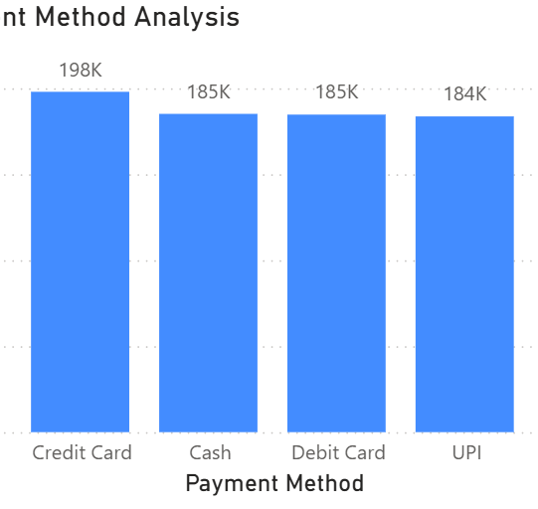
Payment Method Analysis
Visual: Bar chart by payment method
Insight: Credit card most used, UPI growing
Strategy: Incentivize digital payments

Slide 9
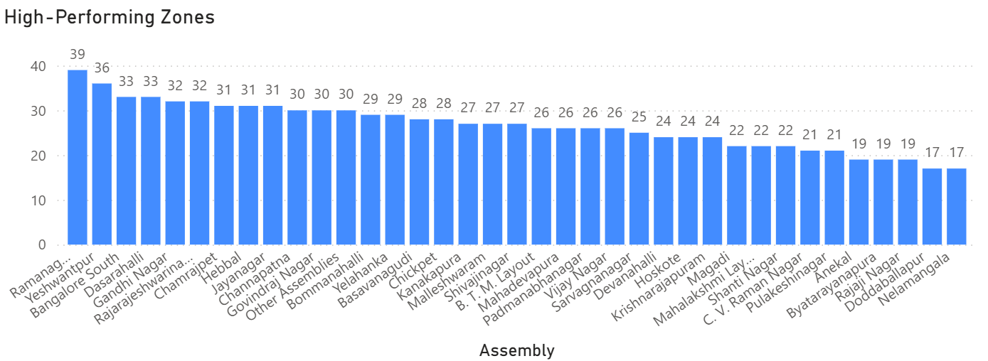
High-Performing Zones
Visual: Bar chart of trip count by pickup zone
Zones: Ramamurthy Nagar, Bangalore South, BTM Layout
Action: Improve resource allocation in high-demand areas

Slide 10
Technical Recommendations
Optimize ride scheduling for mid-duration trips
Use fare-based parameters to filter profitable segments
Monitor cancellation patterns using trip status logic

Slide 11
Operational Efficiency Outcomes
Driver deployment aligned with demand
Reduction in cancellations through ETA visibility
Loyalty incentives for 10–20 min trip range

Slide 12
Conclusion & Next Steps
Dashboard enables real-time insights and targeted improvements
Recommend ongoing monitoring and parameter tuning
Open for Q&A and feedback

